Slide 1
Essential Commands
-Adithya Ayanam
A guide for Seurat v 3 - satija lab

Slide 2
Seurat Standard Workflow
The standard Seurat workflow
Examine raw single-cell expression data
Aims to find clusters within the data.
Process :
Data normalization
Variable feature selection,
data scaling
a PCA on variable features
construction of a shared-nearest-neighbors graph,
and clustering using a modularity optimizer.
Finally, we use a t-SNE to visualize our clusters in a two-dimensional space.

Slide 3
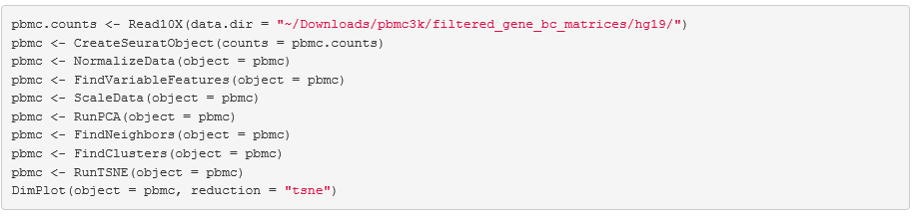
Seurat Standard Workflow
Commands - Standard Workflow - Seurat v 3

Slide 4
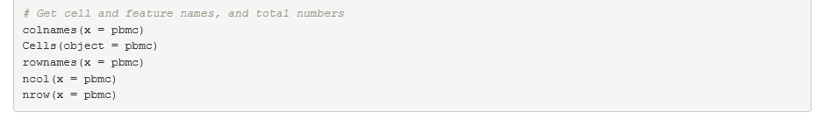
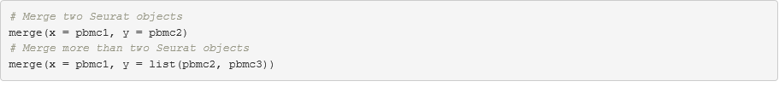
Seurat Object Interaction
Commands - Object interaction - Seurat v 3
To Get cell and feature names, and total numbers
2. To Merge two datasets

Slide 5
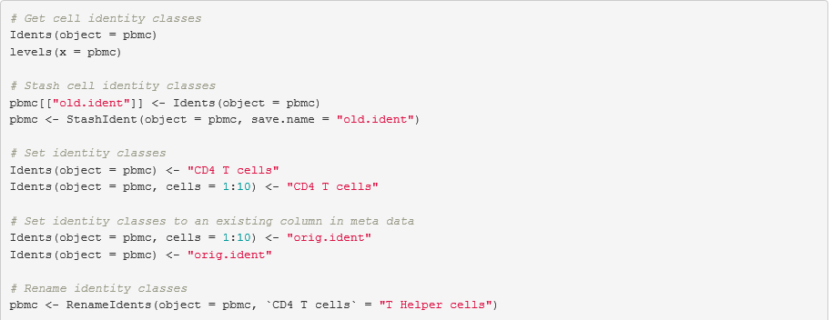
Seurat Object Interaction
Commands - Object interaction - Seurat v 3
3. Identity Classes

Slide 6
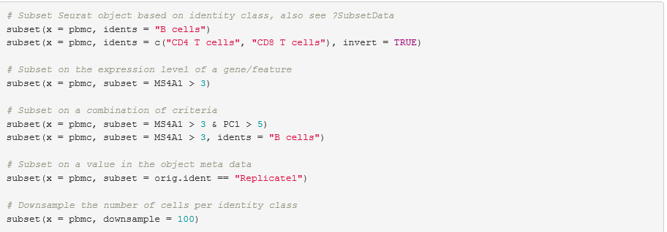
Seurat Object Interaction
Commands - Object interaction - Seurat v 3
3. Subset Command - (replacement for FilterCells command in older version)

Slide 7
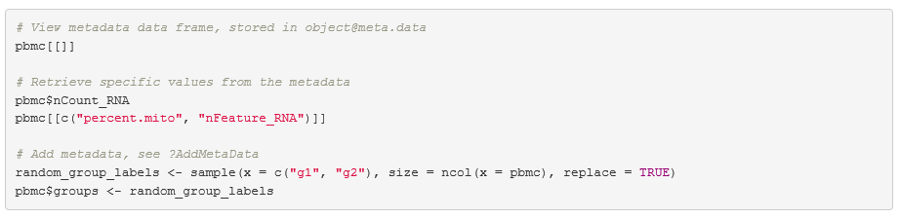
Data Access
Commands - Data Access - Seurat v 3
1. MetaData - Add, View and Retrieve

Slide 8
Data Access
Commands - Data Access - Seurat v 3
2. Expression matrix - Set and Retrieve
3. Cell Embeddings and Feature Loadings
4. Fetch Data

Slide 9
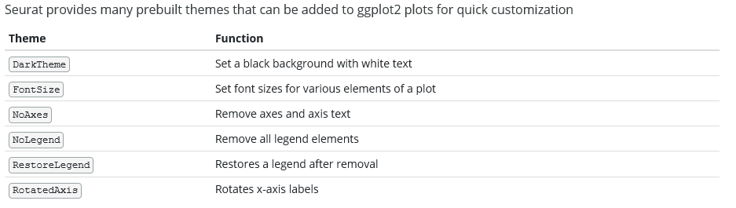
Visualization
Commands - visualization- Seurat v 3
All plotting functions will return a ggplot2 plot by default
Allow easy customization with ggplot2.

Slide 10
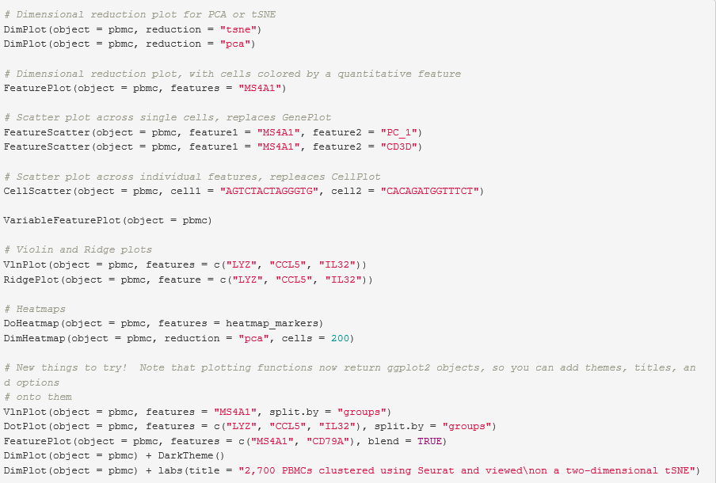
Visualization
Commands - visualization- Seurat v 3 -All ggplot functions

Slide 11
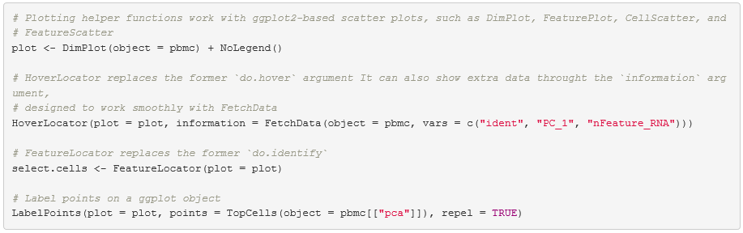
Visualization
Commands - visualization- Seurat v 3 -All ggplot functions

Slide 12
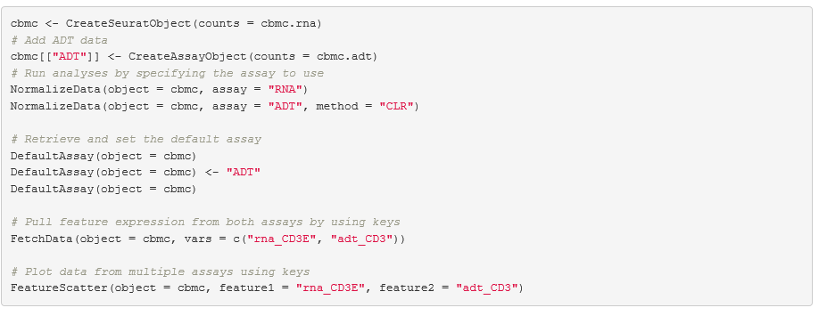
Multi-Assay Features
Commands - multi-assay features Seurat v 3 -All ggplot functions

Slide 13
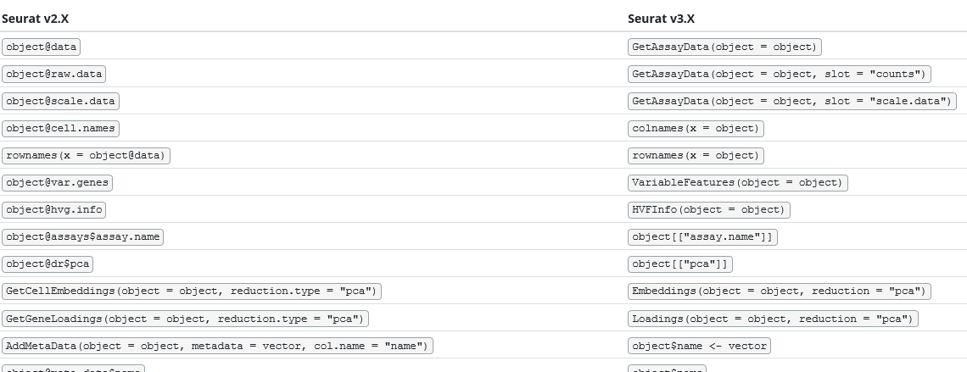
Ver 2 and Ver 3 Differences
Commands - Differences- Seurat v 3 -All ggplot functions

Slide 14
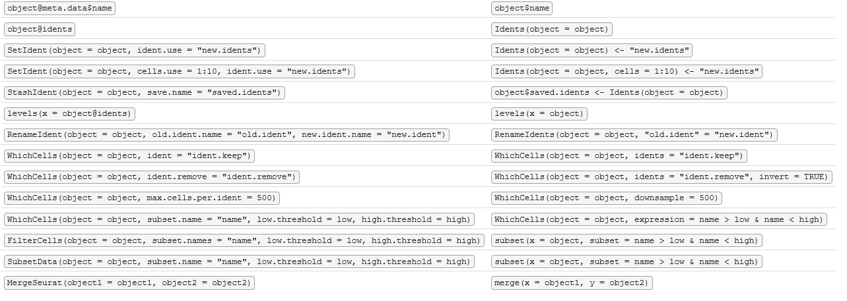
Ver 2 and Ver 3 Differences
Commands - Differences- Seurat v 3 -All ggplot functions
Ver 2 Ver 3

